Slide 1
How to create a business plan
Lecture 08
Yasir Saleem

Slide 2
Why a business plan?
Every business needs to have a written business plan. Whether it’s to provide a direction to the employees or attract investors, a business plan is vital for the success of your organization

Slide 3
Structure of a business plan
Executive Summary -- a snapshot of your business
Company Description -- describes what you do
Market Analysis - research on your industry, market and competitors
Organization and Management -- your business and management structure
Service or Product -- the products or services you’re offering
Marketing and Sales -- how you’ll market your business and your sales strategy
Funding Request -- how much money you’ll need for next 3 to 5 years
Financial Projections – audited accounts and balance sheets
Appendix -- an optional section that includes resumes and permits

Slide 4
Seven steps to writing a business plan
Research
Purpose
Company Profile
Documentation of all the aspects of your business
Strategic marketing plan
Adaptability as per the audience
An explanation to “Why you care”

Slide 5
1. Research, research and research
Spend twice as much time researching, evaluating and thinking as you spend actually writing the business plan.
To write the perfect plan, you must know your company, your product, your competition and the market intimately.
Research and analyze your product, your market and your objective expertise.
In-depth industry knowledge.
“SWOT Analysis”

Slide 6
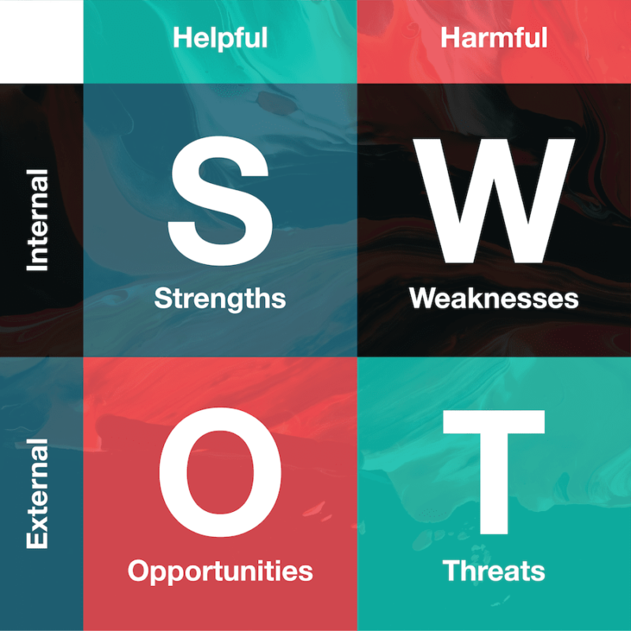
SWOT ANALYSIS

Slide 7
2. Purpose of the plan
Your business plan can serve several different purposes, when you define your plan, make sure you have defined the goals personally as well:
If you’re self-funding or bootstrapping your business as an Entrepreneur ; it should be a road map that provides directions so that a business can plan its future and helps avoiding bumps in the road.
But if you want to attract investors; your plan will have a different purpose and you’ll have to write a plan that targets them so that it will have to be as clear and concise as possible.

Slide 8
3. Company Profile
A Company Profile is not only an essential component of your business plan; it’s also one of the first written parts of the plan.
Your company profile includes the history of your organization, what products or services you offer, your target market and audience, your resources, how you’re going to solve a problem and what makes your business unique.
It could be a part of your company’s official website and is helpful in attracting prosperous customers and talents.

Slide 9
4. Documenting all the aspects of your business
Since you need to convince your investors that your business will make them money, hence they want to know every minute detail about your business;
Document everything from your expenses, cash flow and industry projections including the seemingly minor details such as your location strategy and licensing agreements.

Slide 10
5. Strategic Market plan
A great business plan will always incorporate a strategic and aggressive marketing plan that typically includes achieving marketing objectives such as:
Introducing new products
Extending or regaining market for existing products
Entering new territories for the company
Boosting sales in a particular product, market or price range. Where will this business come from? Be specific.
Cross-selling (or bundling) one product with another
Entering into long-term contracts with desirable clients
Raising prices without cutting into sales figures
Refining a product
Enhancing manufacturing/product delivery

Slide 11
5. Strategic Market plan (contd..)
“Each marketing objective should have several goals (subsets of objectives) and tactics for achieving these goals.” (the 5 Ws and an H)
Objectives Section: ‘what’ and the ‘why’ of the marketing tasks.
Implementation Section: focus on the practical, sweat-and-calluses areas of who, where, when and how.
Budgeting: achieving marketing objectives will have associated costs.
Allocate budgets for each activity planned in a separate section of your marketing plan.

Slide 12
6. Adaptability as per the audience
A Business plan has got several potential and diversified readers ranging from bankers and venture capitalists to employees.
Each type of reader has different typical interests, you should know these interests upfront;
Bankers will be more interested in balance sheets and cash flows
While the Venture Capitalists will be looking at the basic business concept and your management team.
Whereas, your Manager will be using the plan to “remind themselves of the objectives and goals.”

Slide 13
7. Why you care
Whether you’re sharing your plan with an investor, customer or team member, your plan needs to show that you’re passionate and dedicated, and you actually care about your business and the plan.
By explaining why you care about your business you create an emotional connection with others so that they’ll support your organization going forward.

Slide 14
Thank you

